Slide 1

HOUSING PROJECT
SUBMITTED BY
NAINCY JOSHI

Slide 2
DATASET DETAILS
We have two dataset i.e train_data and the test_data.
In train_data SalePrice of the house is given but in test_data,no SalePrice is given,so we have to predict the SalePrice of the test_data.
We have 1168 rows × 75 columns in the train_data while in test_data we have
292 rows × 74 columns.

Slide 3
MSSubClass: Identifies the type of dwelling involved in the sale.
MSZoning: Identifies the general zoning classification of the sale.
LotFrontage: Linear feet of street connected to property.
LotArea: Lot size in square feet.
Street: Type of road access to property.
Alley: Type of alley access to property.
LotShape: General shape of property.
LandContour: Flatness of the property
Utilities: Type of utilities available
LotConfig: Lot configuration
LandSlope: Slope of property and so on.

Slide 4
The numeric data which are present in the dataset
MSSubClass
LotFrontage
LotArea
OverallQual
OverallCond
YearBuilt
YearRemodAdd
MasVnrArea
BsmtFinSF1
BsmtFinSF2
BsmtUnfSF
TotalBsmtSF
1stFlrSF
2ndFlrSF
LowQualFinSF
GrLivArea
BsmtFullBath
BsmtHalfBath
FullBath
HalfBath
BedroomAbvGr
KitchenAbvGr
TotRmsAbvGrd
Fireplaces
GarageYrBlt
GarageCars
GarageArea
WoodDeckSF
OpenPorchSF
EnclosedPorch
3SsnPorch
ScreenPorch
PoolArea
MiscVal
MoSold YrSold
SalePrice

Slide 5
The categorical data which are present in the dataset
MSZoning
Street
LotShape
LandContour
Utilities
LotConfig
LandSlope
Neighborhood
Condition1
Condition2
BldgType
HouseStyle
RoofStyle
RoofMatl
Exterior 1st
Exterior2nd object
MasVnrType
ExterQual
ExterCond
Foundation
BsmtQual
BsmtCond
BsmtExposure
BsmtFinType1
BsmtFinType2
Heating
HeatingQC
CentralAir
KitchenQual
Functional
FireplaceQu
GarageType
GarageFinish
GarageQual
GarageCond
PavedDrive
SaleType
SaleCondition

Slide 6
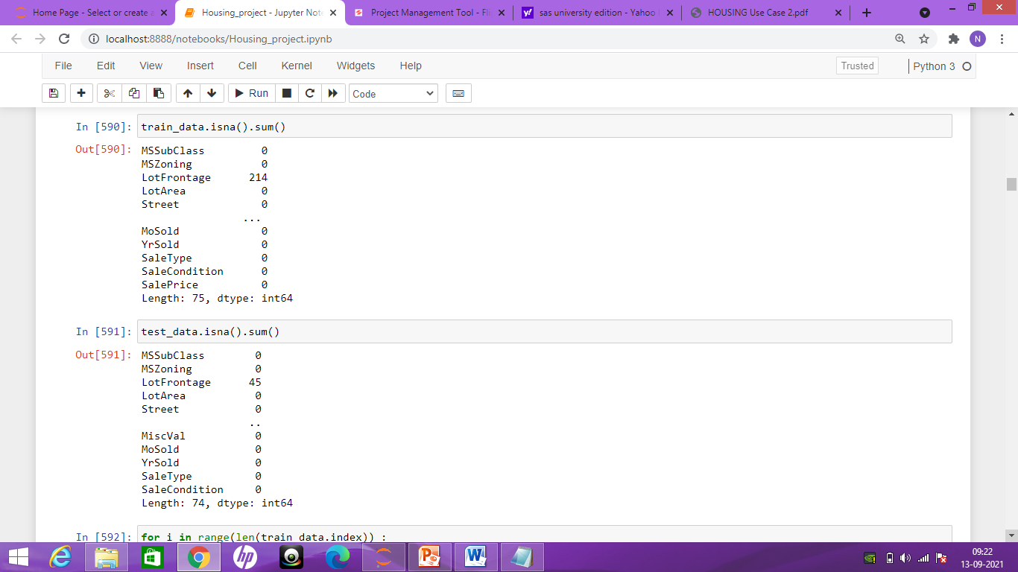
There are lot of missing value in both the dataset.

Slide 7
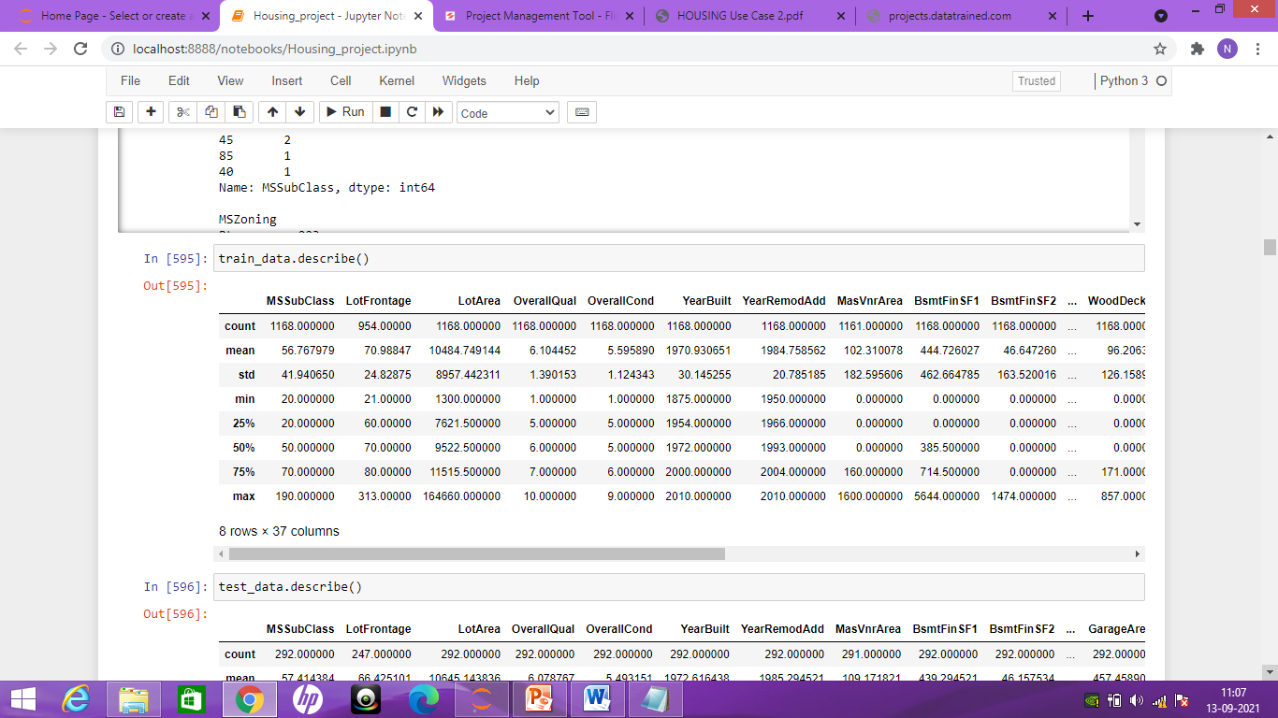
Train_data.describe() will give the detail about the mean,standard deviation and the Quantile

Slide 8
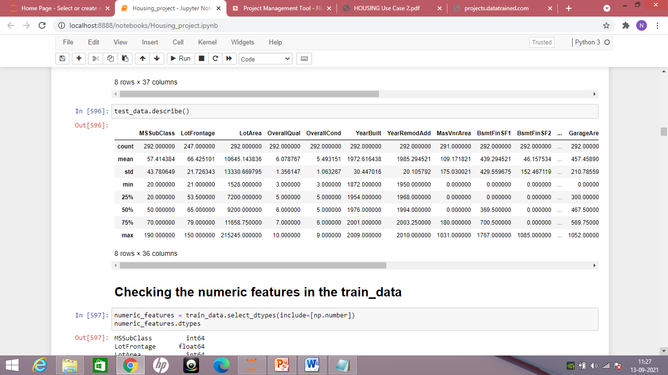
Test_data.describe() will give us mean,standard deviation and the Quantile

Slide 9
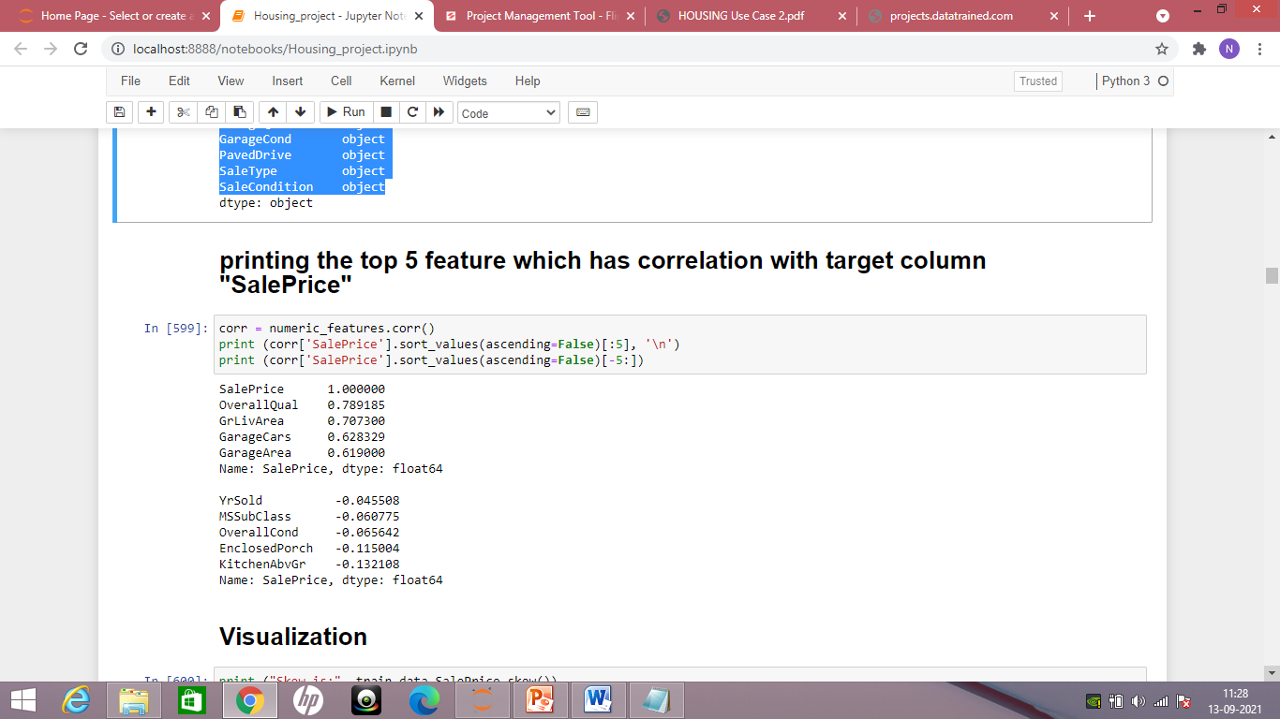
Top 5 feature which has highest correlation with the target column “SalePrice”

Slide 10
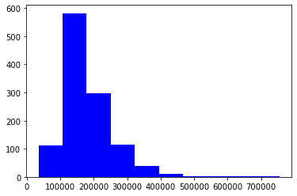
Visualization: The figure shows skewness in the target column “SalePrice”

Slide 11
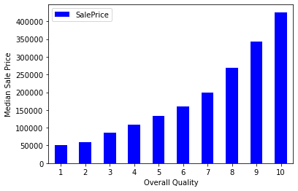
In the graph we can see that the overall Quality increases the SalePrice also increases.

Slide 12
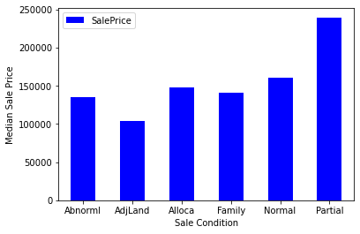
SaleCondition is directly related to the SalePrice.if the condition is good,SalePrice is also good like in partial home is the new homes.

Slide 13
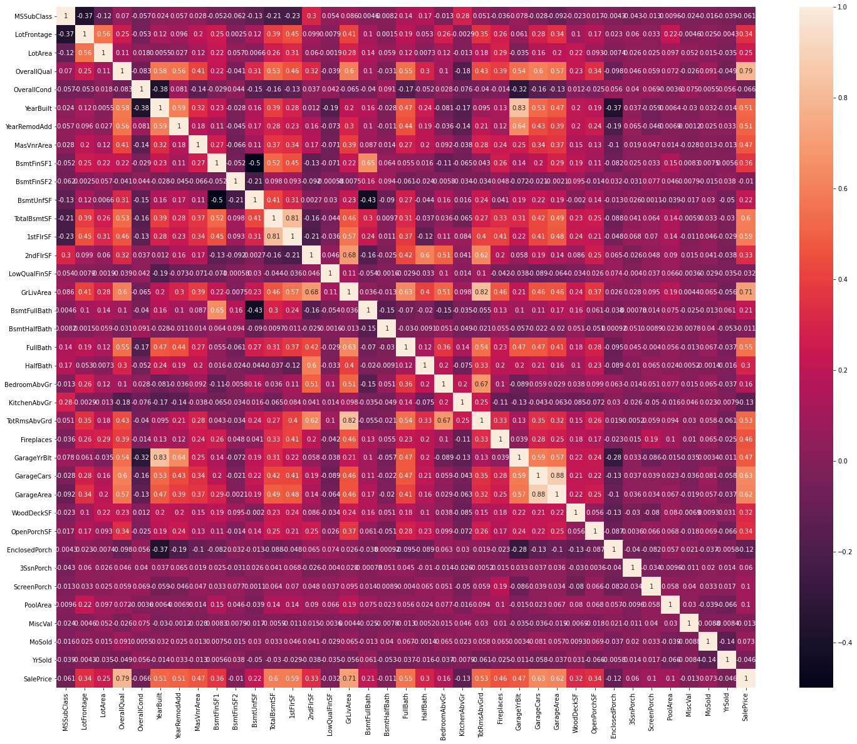
This figure shows the correlation between the features and the target column “SalePrice”

Slide 14
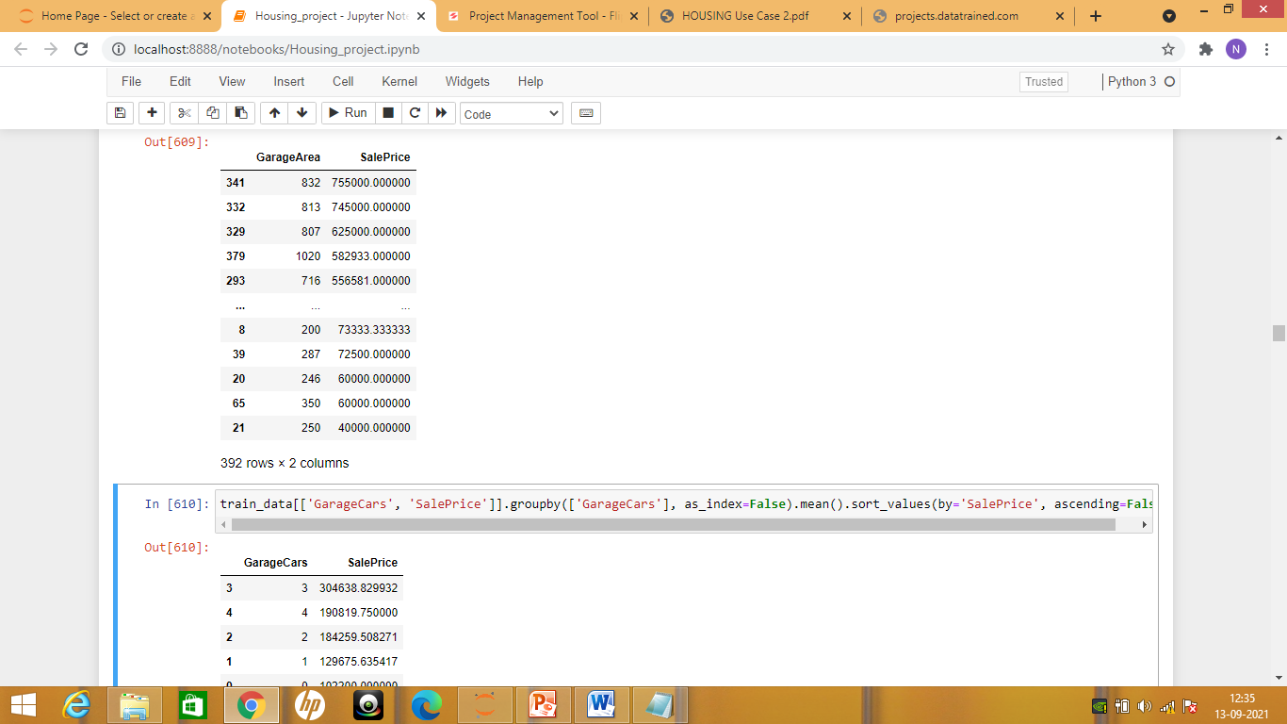
More the GarageArea and the GarageCars ,more the SalePrice of the houses

Slide 15
Visualization Conclusion:
We have lot of missing value in both the dataset.
We have to encode the categorical data into numeric form.
Highest correlation with the target column 'SalePrice' is with the 'OverallQual','GriLivArea','GarageCars','GarageArea'
The 'AdjLand' and the 'Abnorml' have the least SalePrice while the 'partial' and the 'Normal' have the highest SalePrice
The Quality '1' has less price while the Quality with '10'have the highest SalePrice
As the GarageArea increases the SalePrice is also increases
Most of the people have '3' cars space in their houses

Slide 16
Preprocessing Model
Imputing the missing value and the 'NAN' value in the train_data set and the test_data set.
We will fill the “Nan” value using data.fillna(0),we can also use bfill and ffill to fill the Nan value.
For imputing the missing value,we can use mean,mode and the median.
If the missing value is ‘int’ we can use mean/mode,if it is an object,we can use ‘mode’ and the the missing value is a float then we can use ‘mean’

Slide 17
Lets look Out First that Whether both The data are "Set"
The train_data and the test_data should have the same feature in the dataset.
If they are not “set” to be true, we will make them as a True to set.
We can use the replace or add the column in the dataset to make it as a True
If the data are set then they are ready to perform the “LabelEncoder”.labelEncoder is used to encode the object datatype in the dataset.

Slide 18
Splitting the train_data set
Splitting the data into “X” as a feature and “Y” as the target column or the vector i.e “SalePrice”.
X = train_data.drop(['SalePrice'],axis=1)
Y = train_data['SalePrice']
Then we split the data into train_test_split to train and test the data.

Slide 19
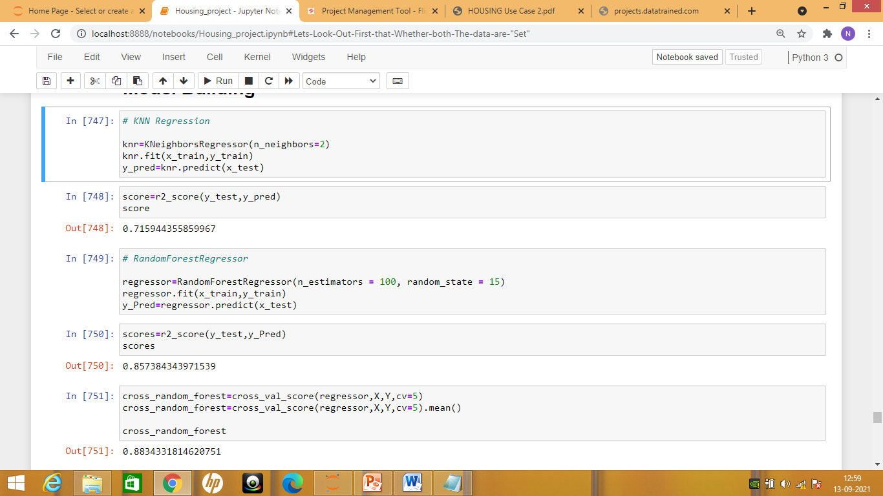
Model Building

Slide 20
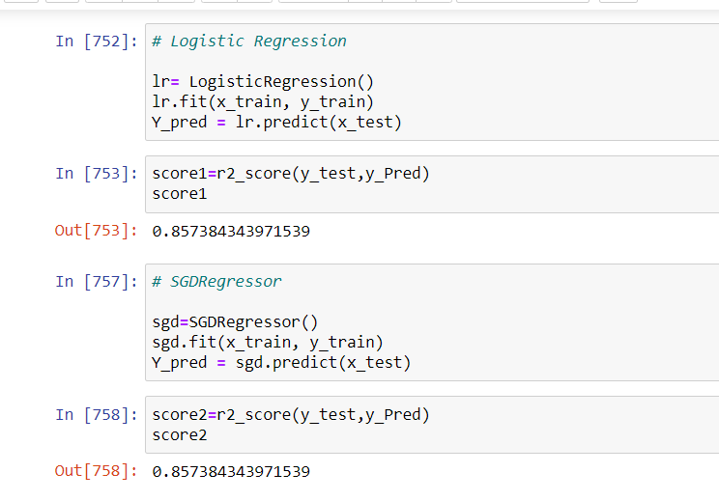

Slide 21
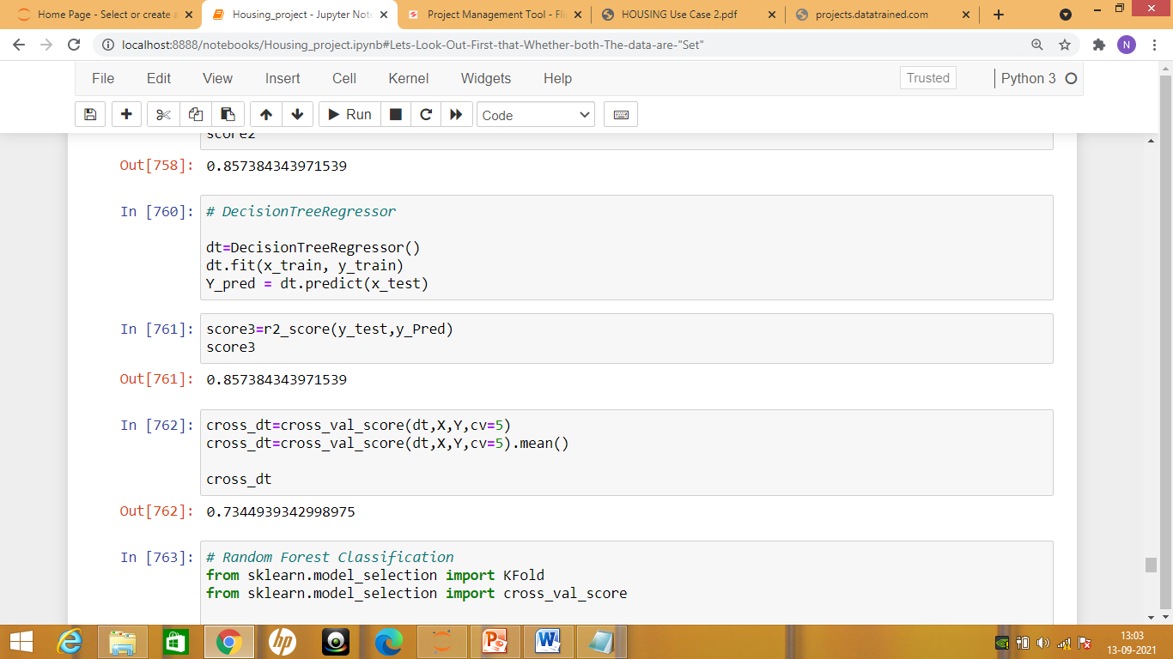


Slide 22
Model Building Conclusion:
We have find that RandomForestRegressor has the least difference between the accuracy score and the cross_validation.
So we will perform hyper-parameter tunning to this model so that we can improve more to give the best accuracy score.

Slide 23
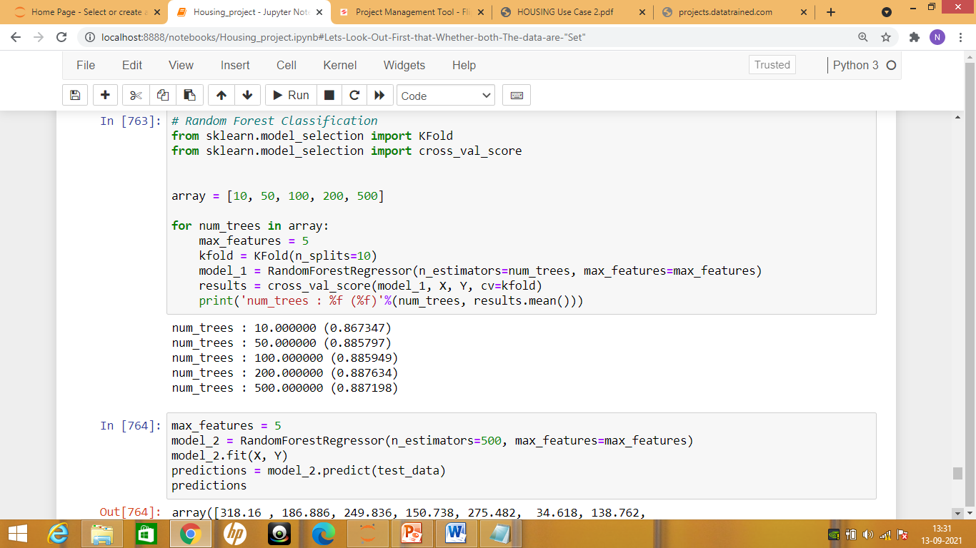
Hyper-parameter tunning:

Slide 24
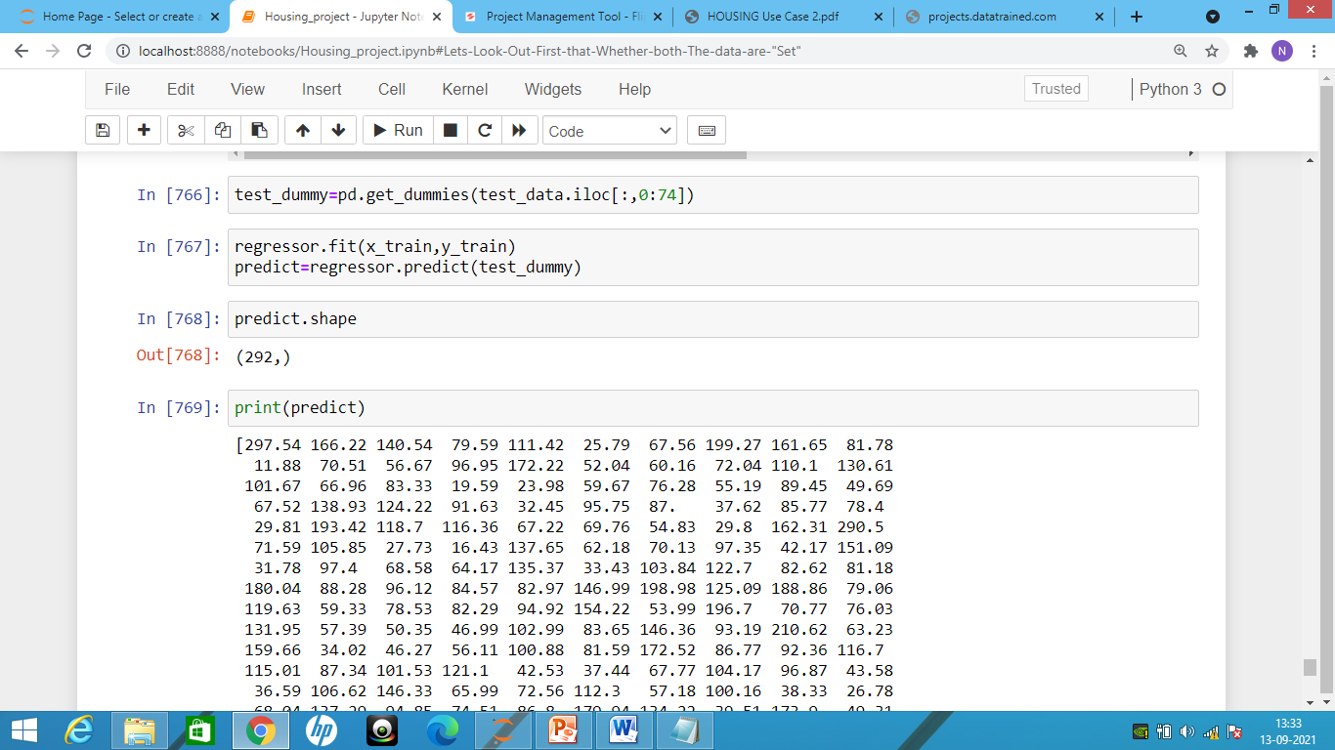
Predicting the SalePrice of the test_data

Slide 25
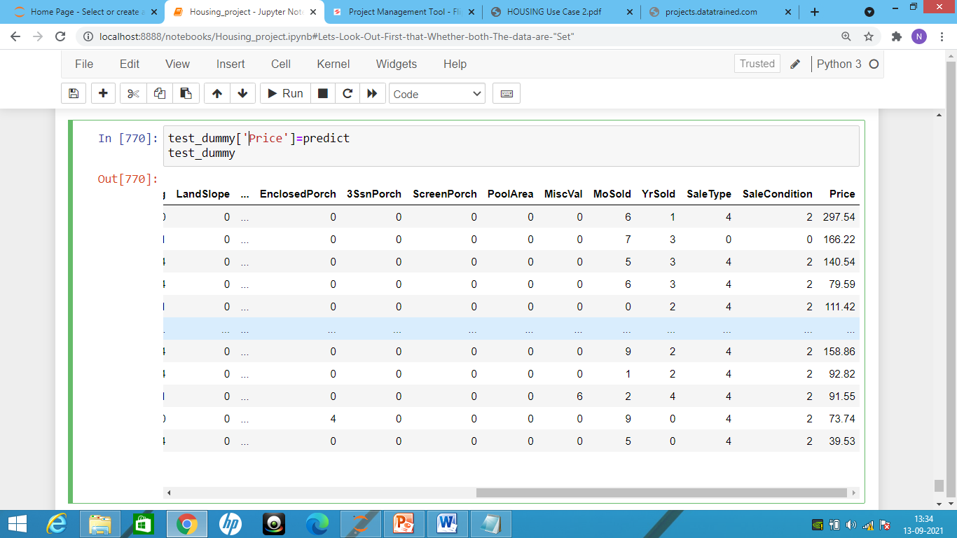
Successfully predicted the Saleprice of the test_data:

Slide 26
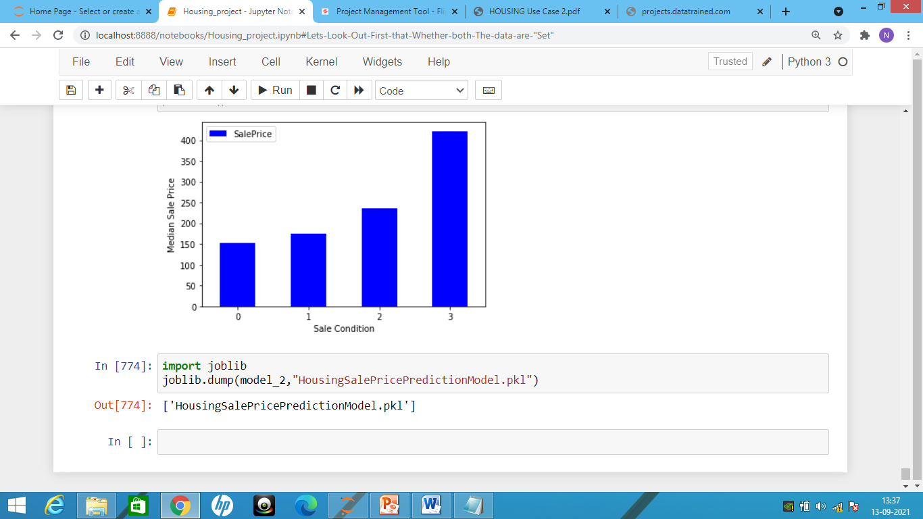
Saving the Model using Joblib:

